Slide 1
Common Problems and Solutions Bagfilter problems
Findings & Observations

Slide 2
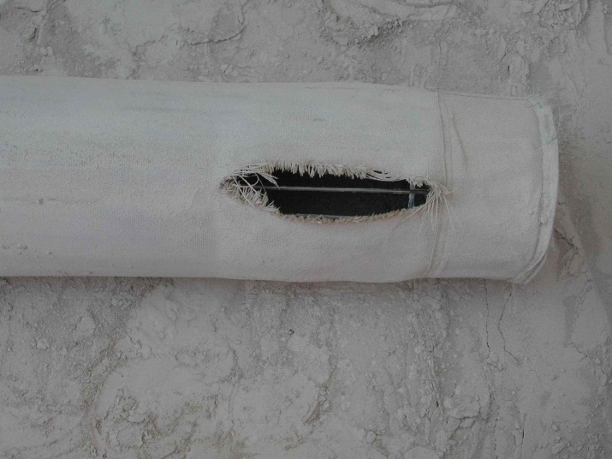
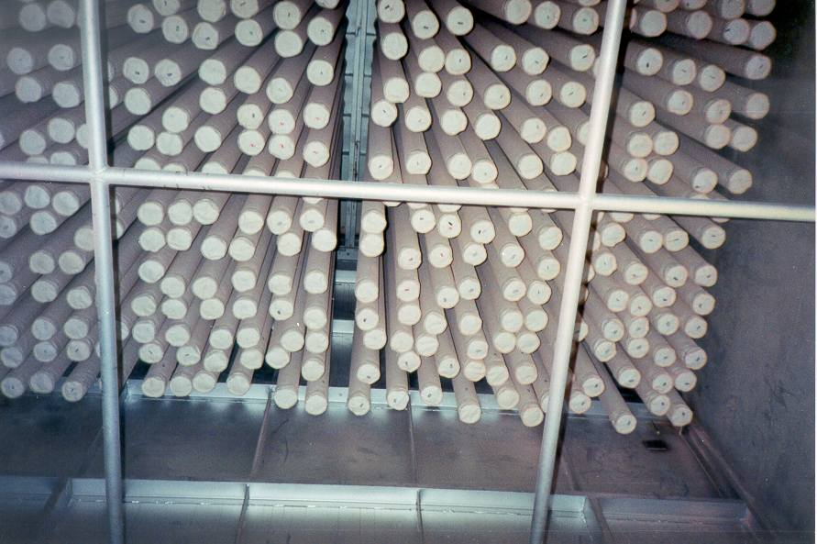
Findings & Observations
Industrial sludge (up to 3 t/h) is fed to the raw mill leading to additional moisture as well as high VOC (500 mg/Nm3) in the exhaust gas in compound operation
The tube sheet has not been installed horizontally in a nice way leading to clusters of bags touching each other
The casing of the filter shows traces of corrosion due to condensation and acid corrosion (HCl, SO3)
Precoating of bags has never been done
Notes:
Sludge: Brasil
Tube sheet: Chekka, Ibity
Touching of bags: damage above reinforcement

Slide 3
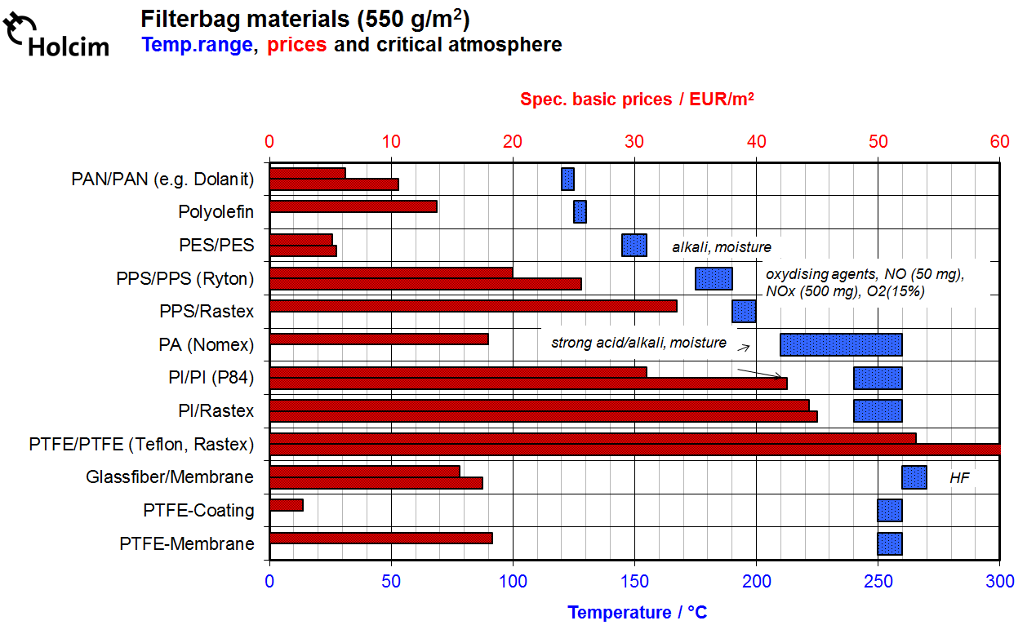

Findings & Observations
Hg?
D/F?
Notes:
Nomex: Problematic if moisture present
Ryton: O2 destroys polymers

Slide 4
Findings & Observations
A measurement showed that the pressure of the cleaning air is 1 bar only
The blow pipes are not correctly aligned (dislocation in the x as well as the y-axis.
The cleaning air is not dried
The temperature drop over the filter is 4 K
The dust is enriched with chlorine (up to 1.5%) due to AFR utilization
Notes:
Oil is disturbing membrane valves
T drop normally < 5 K (indication for low false air)
Chlorine example from Lumbres and Eclepens

Slide 5
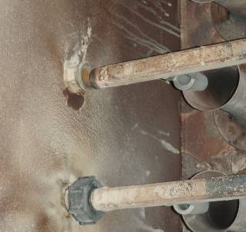
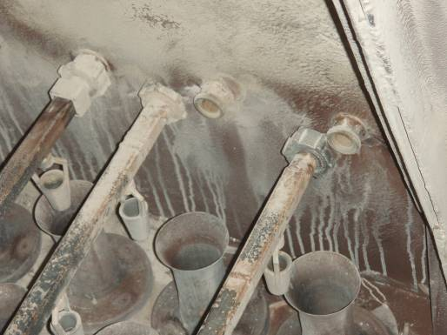
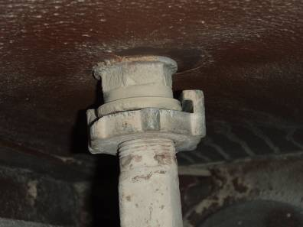
Inefficient cleaning

Slide 6
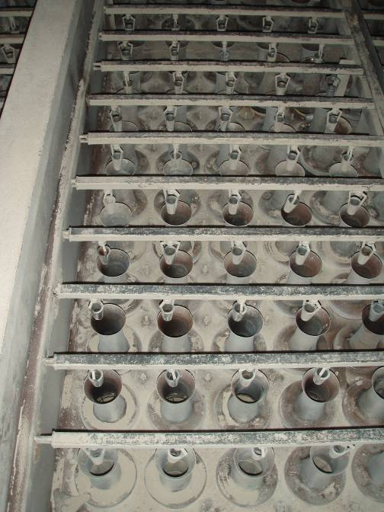
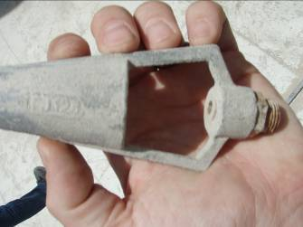
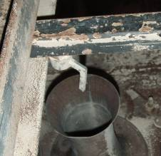
Quality

Slide 7
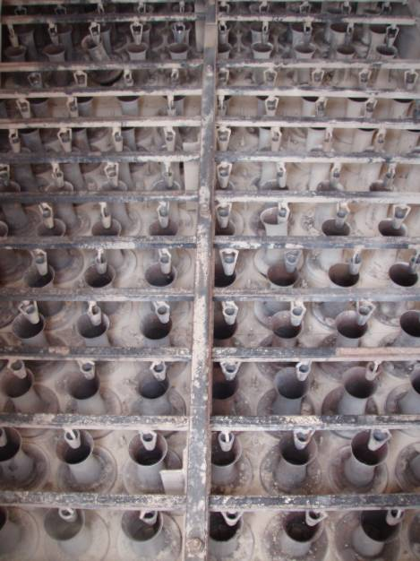
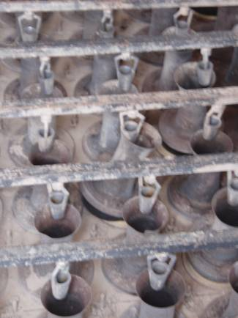
Misalignment Moving venturi
Notes:
- Doppel-Venturi Effekt (Redecam)

Slide 8
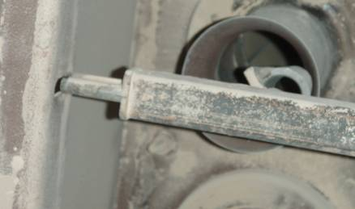
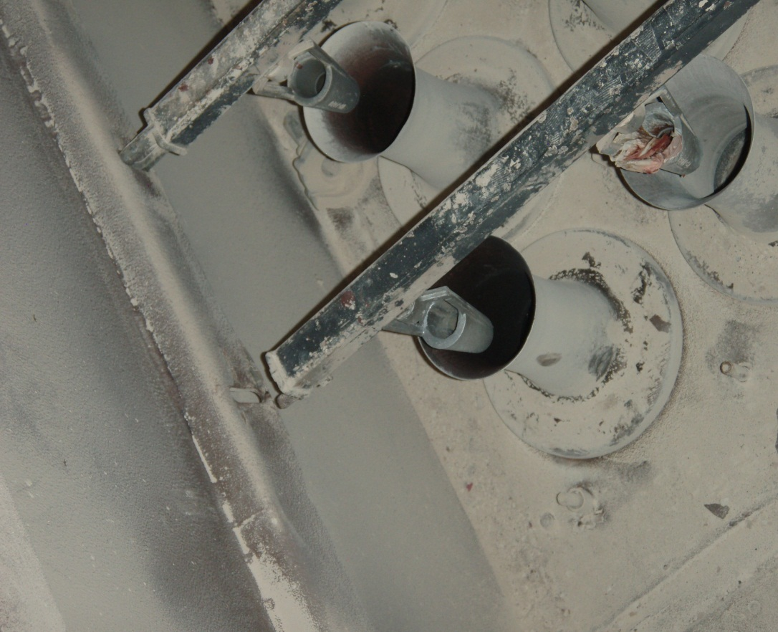
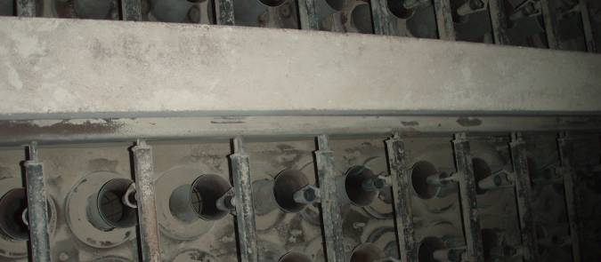
Blow pipes not hold/no fit

Slide 9
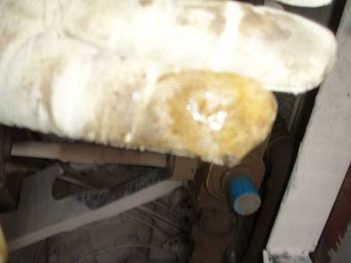
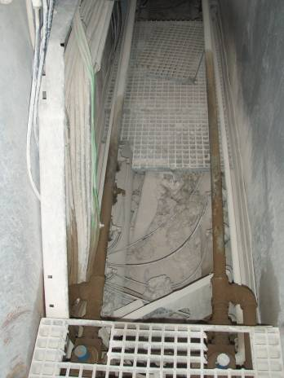
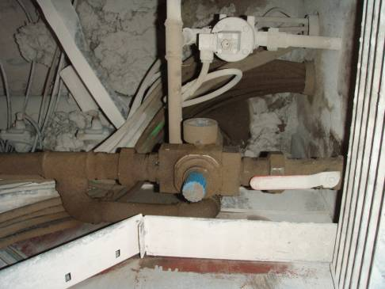
Insufficient cleaning air quality
Water and oil free air quality is a must!
Notes:
Öl von Kompressoren
Keine Abscheider vorhanden, Kontamination der Bags von innen
Schlechte Anordnung des Steuersystems (Schläuche, Leitungen etc. unter dem Gitter)

Slide 10
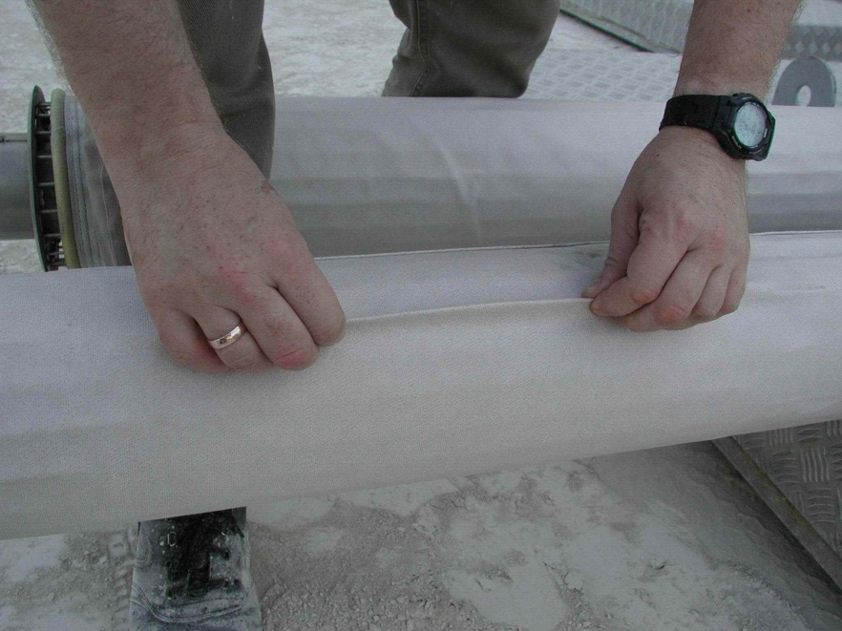
Findings & Observations
Bag cleaning is made on a fixed time interval (every 10 minutes)
The air-to-cloth ratio equals to:
1.8 m/min in compound operation
1.69 m/min in direct operation
The can velocity is 2.1 m/s
The velocity in the inlet duct of the filter equals to 8 m/s
The bag cages have a diameter of 156mm, the bags of 160mm
Notes:
Gas strömt die Schläuche von unten an → hohe Can-Velocity
Zuviel Spiel zwischen Käfig und Schlauch, Schläuche knallen nach der Abreinigung wieder zurück and den Stützkäfig

Slide 11
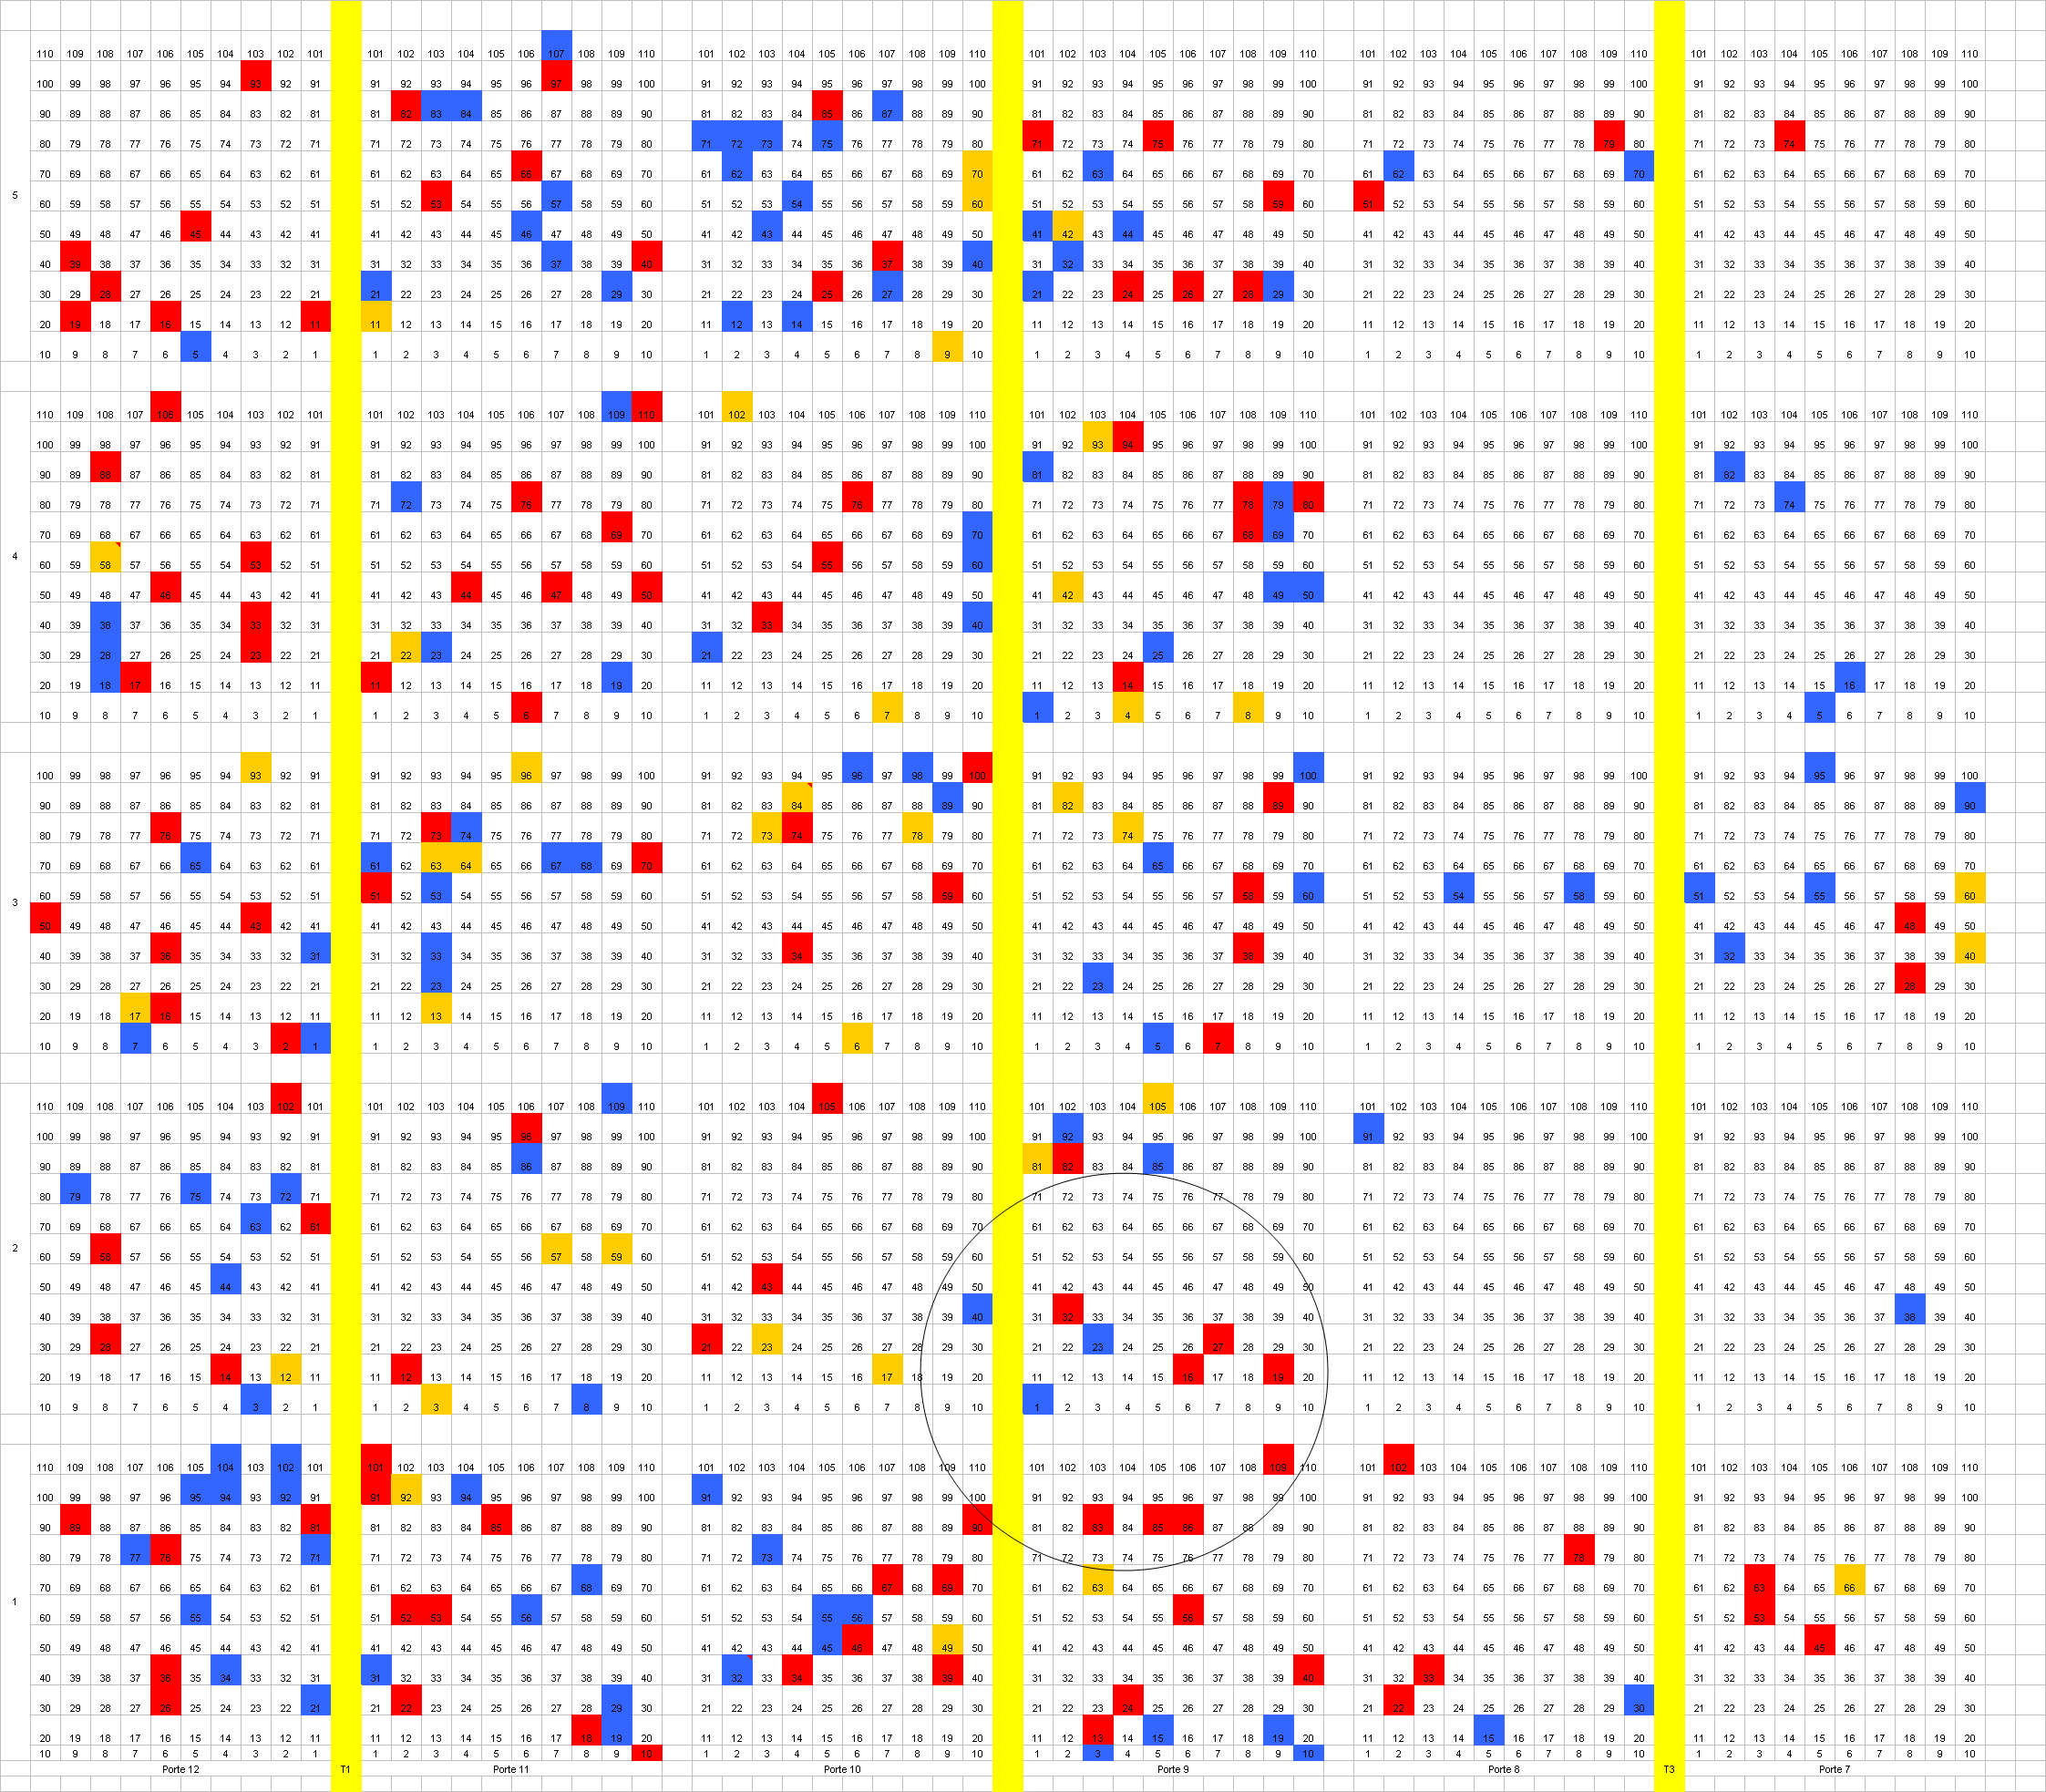
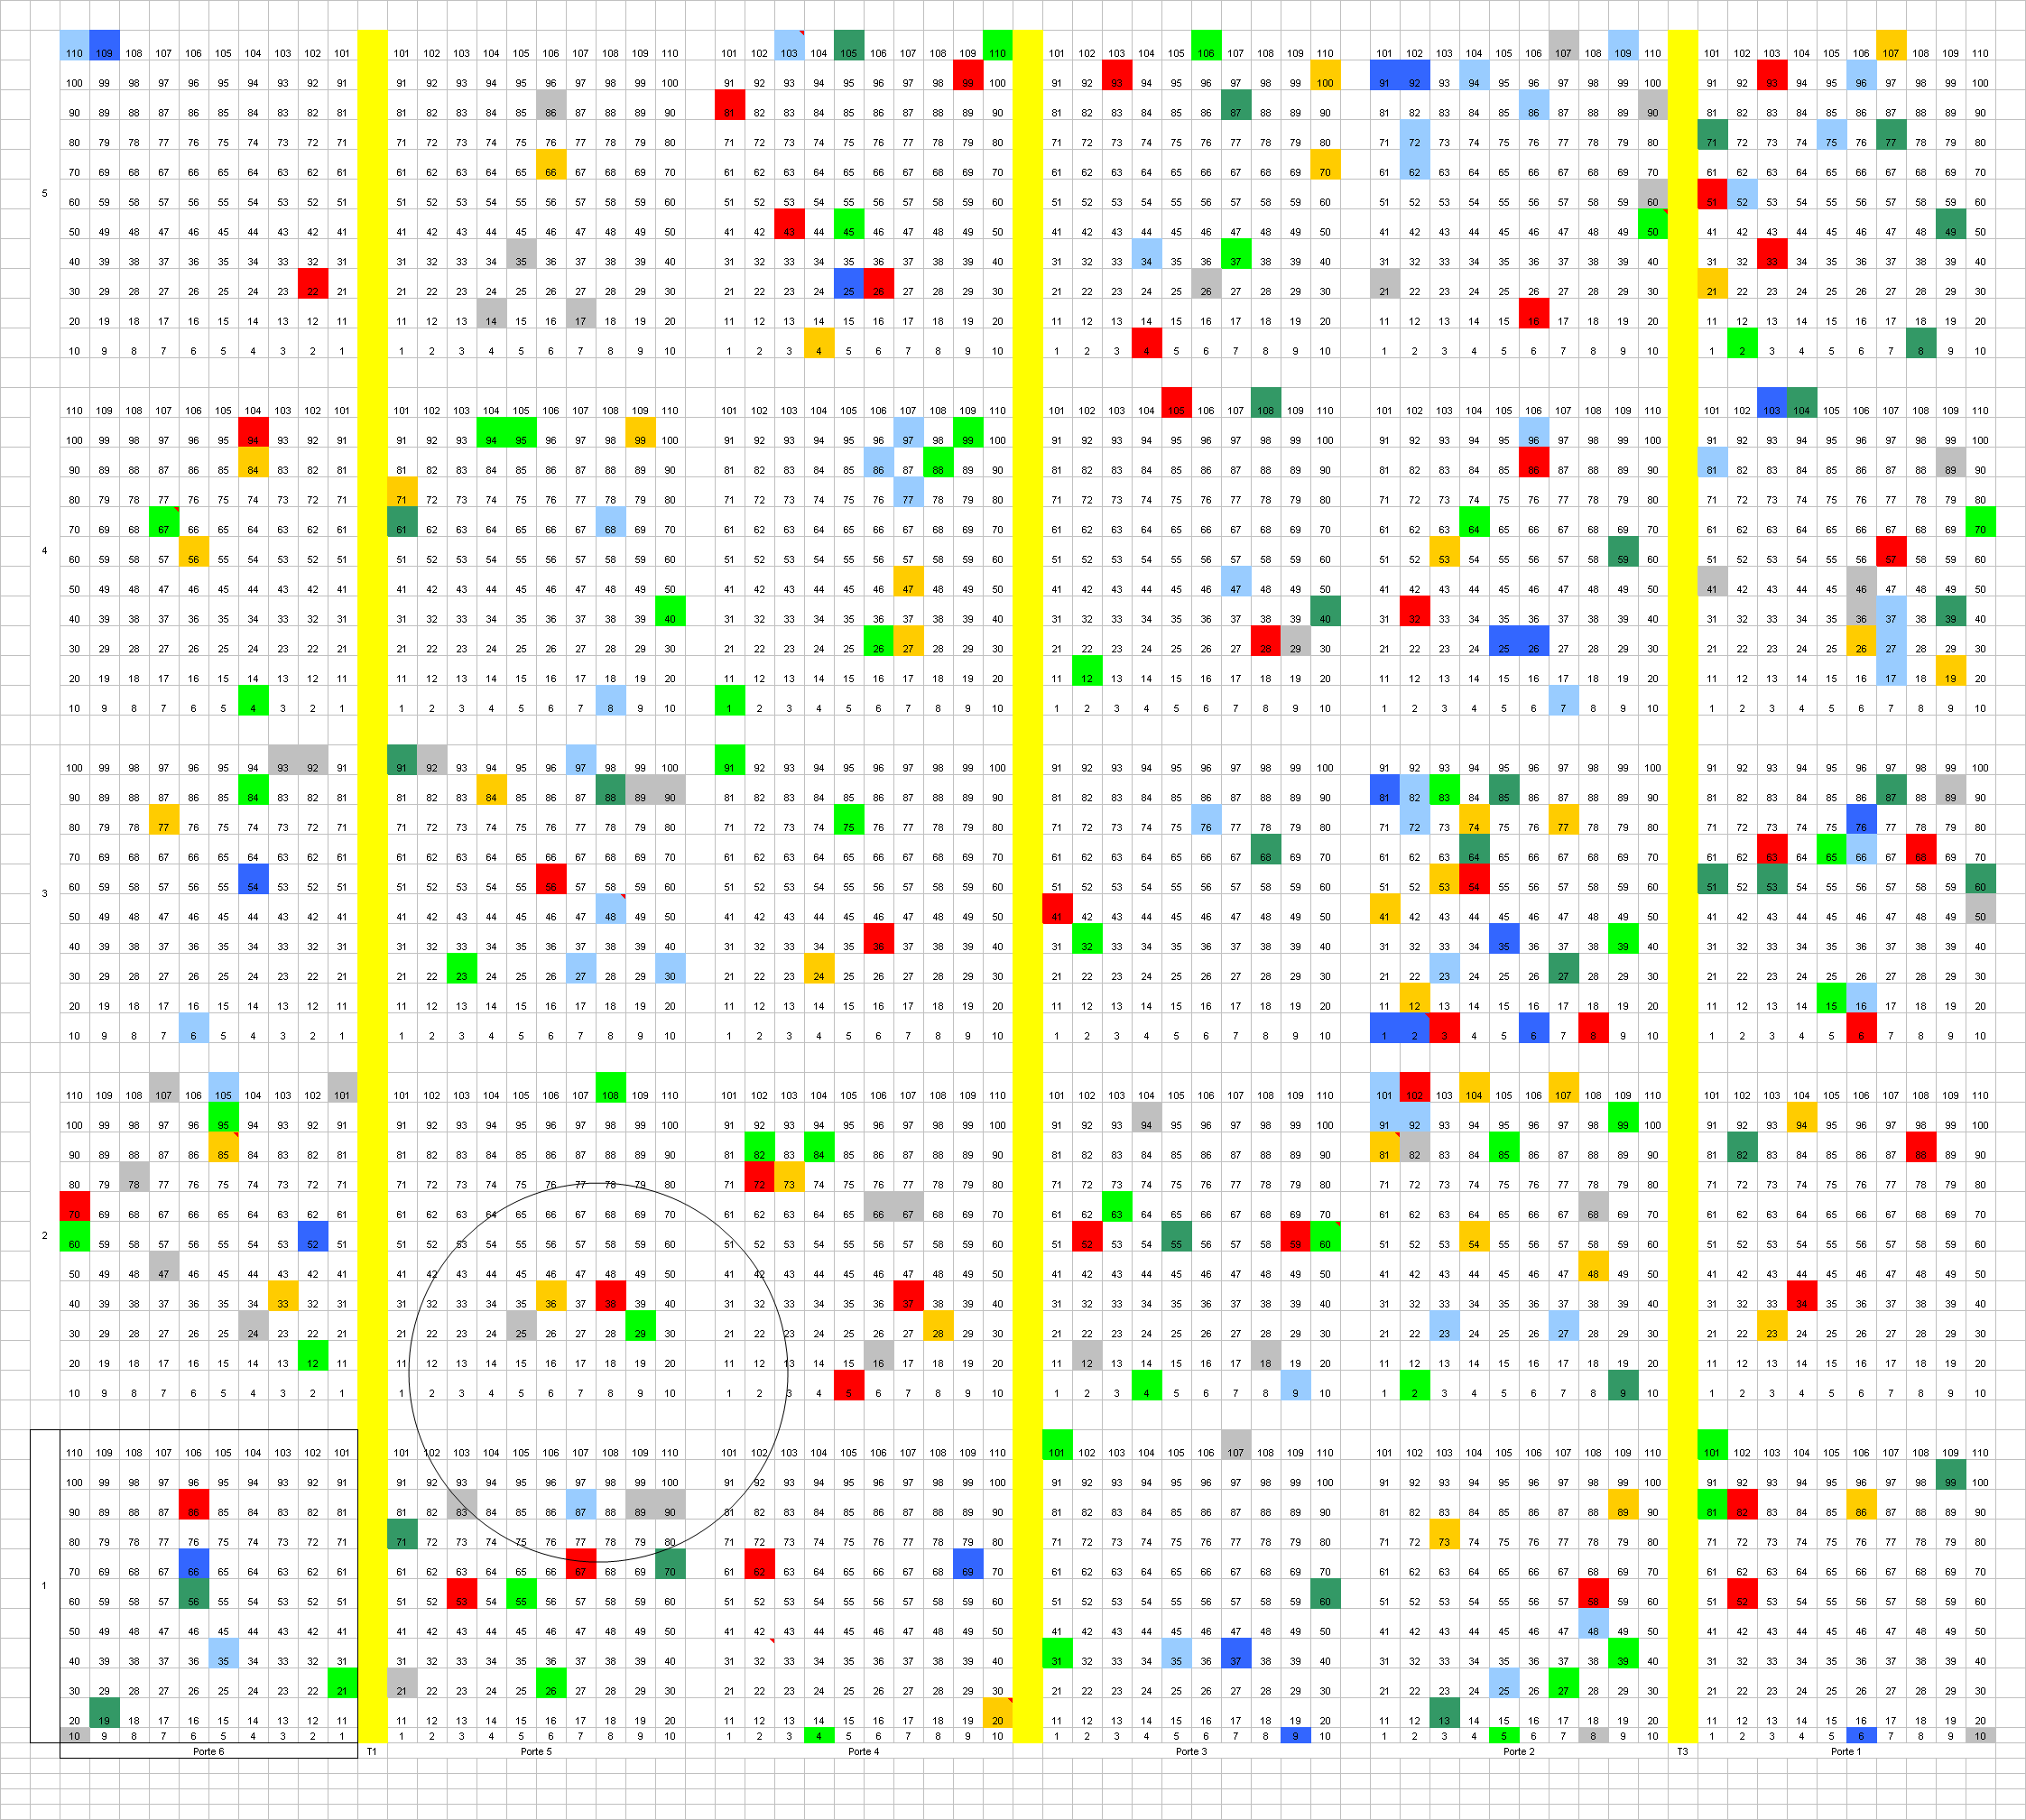
Uneven wear of bags in the compartments
Side T
Side B
Notes:
Farbcode: Schlauchinspektion über mehrere Jahre
Side T = Tripolis
Side B = Beirut

Slide 12
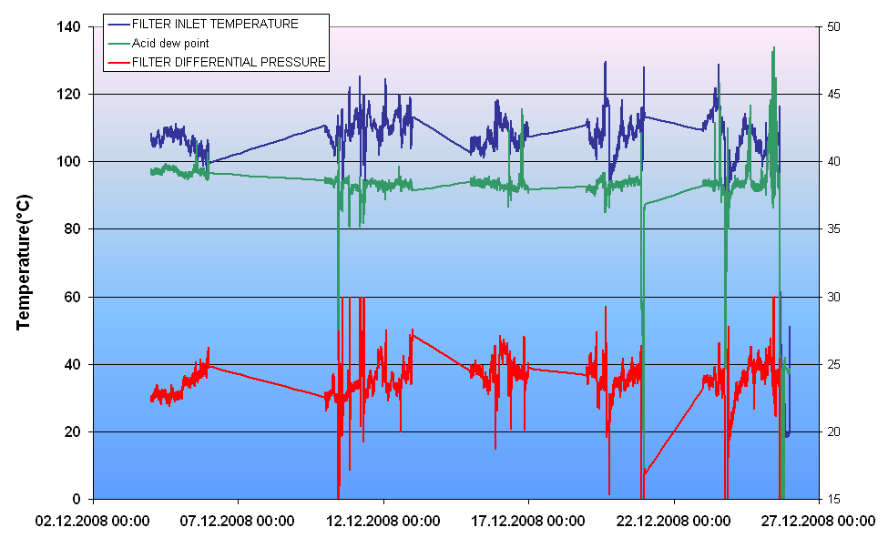
There were periods where the filter was operate below the acid dew point
Notes:
Bei Taupunktunterschreitung entsteht klebriger Staub → delta p hoch
Mind 20 delta T zu Säuretaupunkt

Slide 13
Main Causes
A/C too high
Can velocity too high
Insufficient cleaning air quality and pressure
Inadequate cleaning cycle
Wrong bag quality
Bad installation of certain elements (blow pipes, tube sheets)
Bag-cages dimension problems
Operation below the acid dew point

